Slide 1
PROJECT TITLE
Online Test Series application
By:- Tanaya Jadhav

Slide 2
PROBLEM STATEMENT
Online Examination System has become a fast growing examination method because of its speed and accuracy. It is also needed less manpower to execute the examination. Almost all organizations now-a-days, are conducting their objective exams by online examination system, it saves students time in examinations.
The functionalities of admin are:
Create test
Search test
All the mentioned functionalities are to be developed as dedicated user stories which would be part of particular sprints. The development would be in an incremental manner.

Slide 3
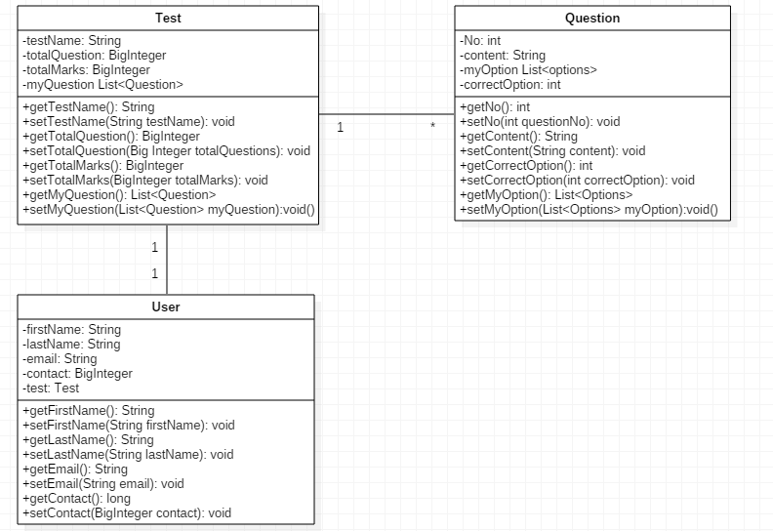
POJO CLASSES

Slide 4
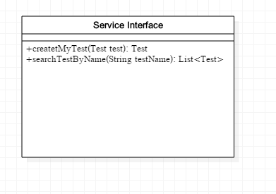
SERVICE INTERFACE

Slide 5
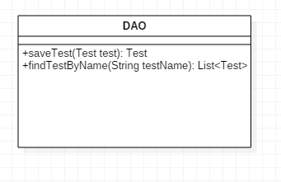
REPOSITORY

Slide 6
THANK YOU

